Slide 1
Groups: Groups are used to combine dimension members to create higher level member.
i.e. Process of combining multiple members from a single dimension into a higher category.
Ex1:-
Drag States on Row shelf and sales on Cols shelf.
Right click on Dimension States and choose Create→ Group
Give name as Top 10 States and click on Group then all selected states are combined together and one new field is created.
3. Now go to next sheet2 and on that drag Top 10 states in the Ro and Sales on Columns.

Slide 2
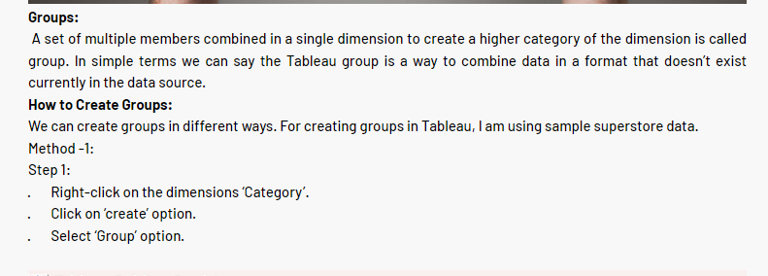
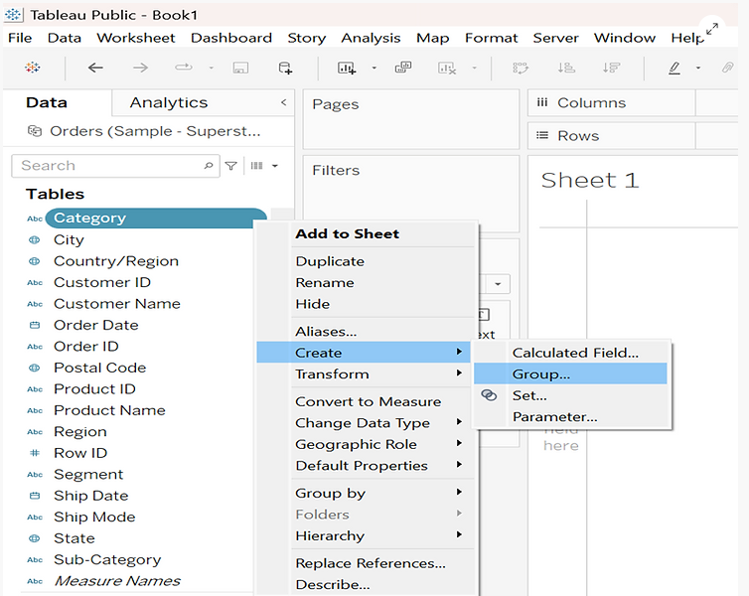

Slide 3
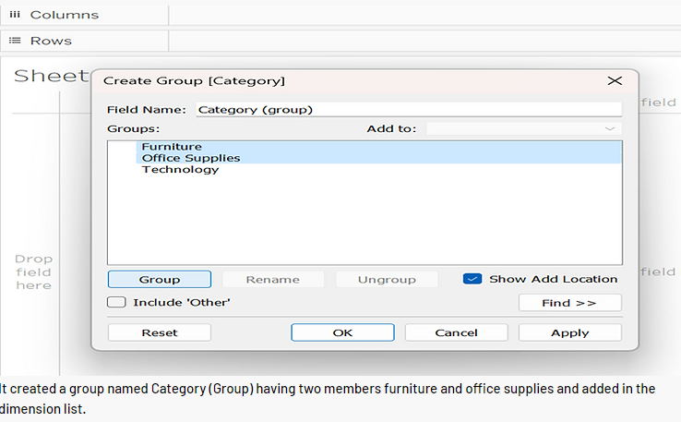
Step 2:
· It opens the ‘Create Group’ window.
· Type the name of the group in field name.
· Select the members to be grouped.
· Click on ‘Group’ button.

Slide 4
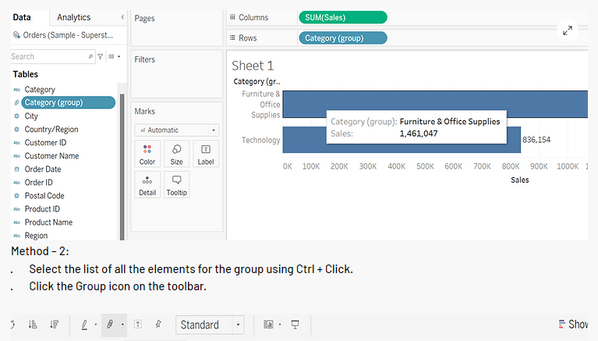

Slide 5
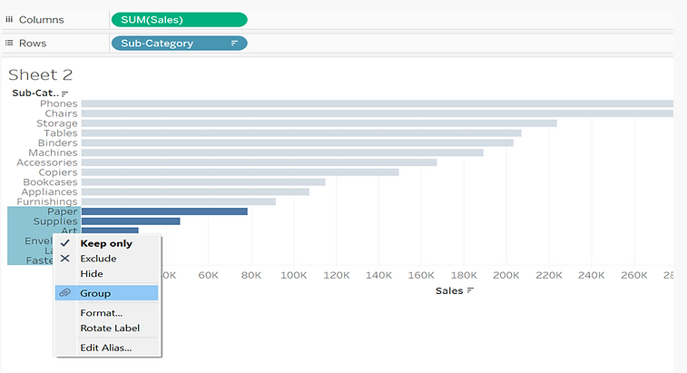
Method – 2:
· Select the list of all the elements for the group using Ctrl + Click.
· Right-Click on the highlighted elements.
· Select Group.

Slide 6
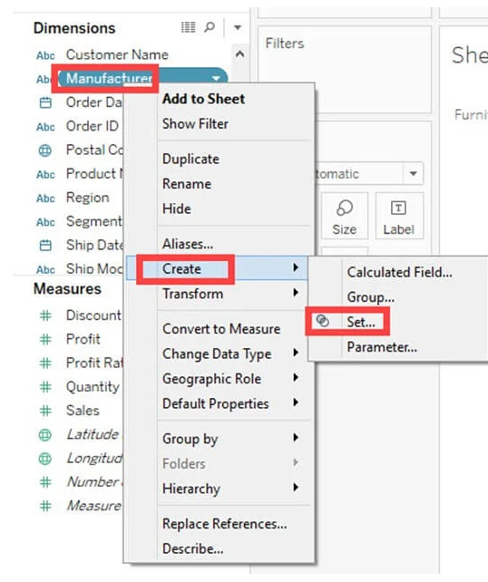
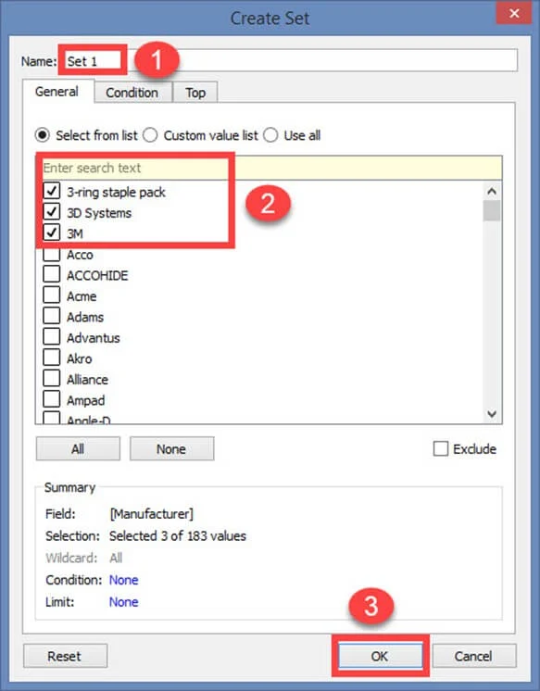
Sets: Sets are custom fields that are used to keep a subset of data based on a condition.
i.e. sets are custom fields that define a subset of data based on some condition.
Step 1) Go to a Worksheet.
Right-click on a dimension.
Select ‘Create’ option.
Click on ‘Set’ option.
Step 2) It opens ‘Create Set’ Window.
Name the set to be created.
Select the members needs to be added
in the set.
3.Click on OK.
This creates a
set of the
given name.

Slide 7
A tableau parameter is similar to a calculated field in that it's not a part of the dataset — instead, the tableau developer creates it.
It's also similar to a filter, in that an analytics consumer will usually see a Tableau parameter on a dashboard they can click to customize the view.
It differs from a calculated field and a filter.
Before we begin creating a parameter in Tableau,
here are some of the most common uses of Tableau parameters:
Creating a top x filter
Changing the dimension or measure displayed in a chart
Selecting a single value to highlight

Slide 8
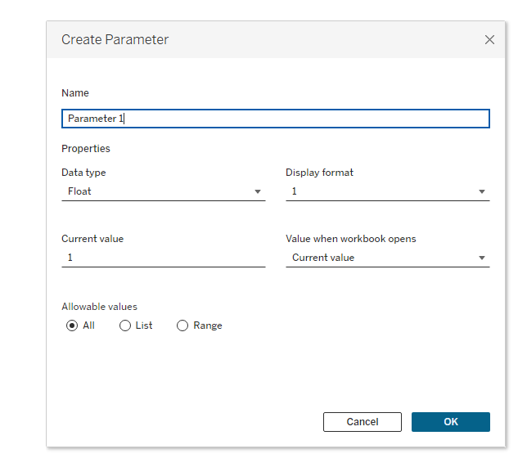
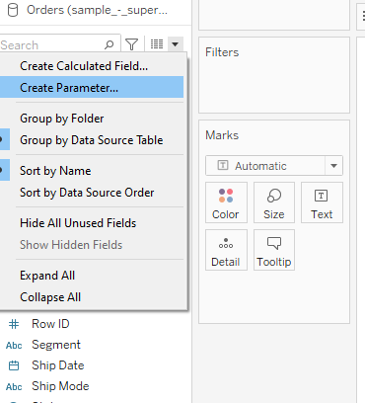
How to Create a Parameter in Tableau
Creating parameters in Tableau begins the same way as creating a calculated field.
Click on the drop-down arrow to the right of the search bar.
Select Create Parameter.

Slide 9
Data type: Where we select if this will be a float, integer, string (text) or date type.
Display format: Allows us to format the value (e.g., change it to a currency).
Current value: This is the default starting value.
Value when workbook opens: Here, the default is current value.
Allowable values: The default is all, which means any value that is a float (so all decimal numbers) are valid input.
A List means that we, as the developer, give the user a predefined list of allowable values to pick from.
Range (not available for text parameters) allows us to set a start and end point, and all values between the start and end points will be valid.

Slide 10
Most frequently used Parameters in tableau:
Top N parameters
Date Field parameter
Dynamic Measures
Dynamic Dimensions
Dynamic Measures and Dimensions
Reference Lines
sets

Slide 11
Top N Parameter:-
How to display the top selected number of values in a dimension, based on a measure via a Top N parameter.
Answer:
use of the Sample - Superstore, follow these steps:
Drag “ Sub category "to the Rows shelf.
Drag "Sales" to the Columns shelf.
Apply filter on subcategory then choose Top10 ; by field: choose create parameter
Name it as Top N parameter in List
Value 15, 10,5 now click ok
Parameter is created.
5. In the Data pane, under Parameters, right click on "Top N" and select Show Parameter Control.
6. In the upper right corner of the view, there is now a "Top N" slider and number field. Changing this field by moving the slider, will change what is shown in the view.

Slide 12
Date Field Parameter:
Choose create parameter name it as : Date Parameter
data type : string List values→ Year, Quarter, Month, Week, Day
2. Now create calculated field: name it as Date Calculated:
with following formula:
[Parameters on their own aren't helpful, so we must always take the second step of adding them either to our visualization or to a calculated field. ]
CASE [Date parameter]
WHEN "Year" THEN STR(YEAR([Order Date]))
WHEN "Quarter" THEN STR(YEAR([Order Date]))+"/Q"+DATENAME('quarter',[Order Date])
WHEN "Month" THEN DATENAME('month',[Order Date])+" "+ STR(YEAR([Order Date]))
WHEN "Week" THEN "week" +STR(DATEPART("week",[Order Date]))
WHEN "Day" THEN STR(DATE([Order Date]))
END

Slide 13
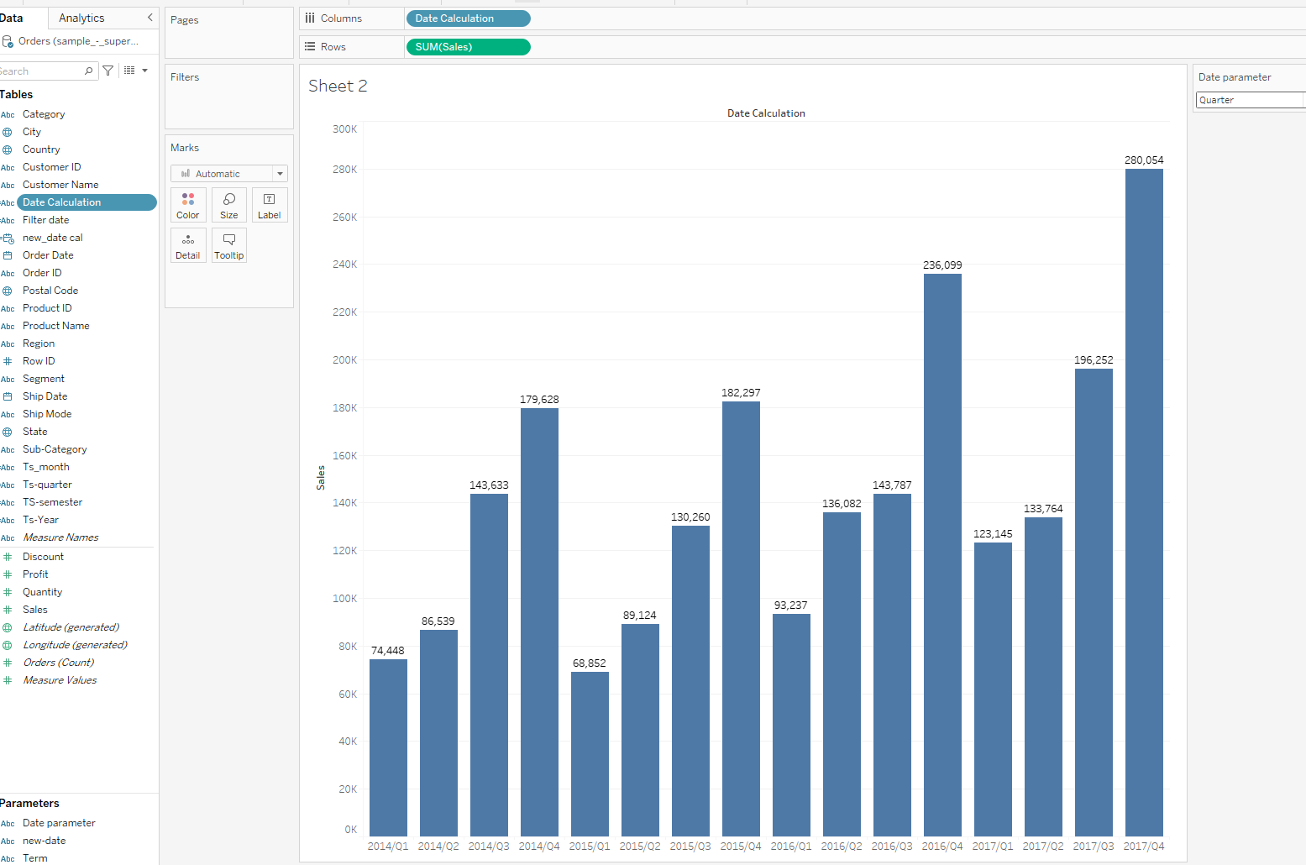
Now, drag sales on Rows
Date calculation on cols
And choose show parameter and click on it.

Slide 14
Ex2: -How to change date level in Tableau using parameter.
Create parameter name it as new-date {datatype: string values: day, month, year}
Noe create calculated field as new-date Cal with following formula
CASE [new-date]
when 'day' then DATETRUNC('day',[Order Date])
when 'month' then DATETRUNC('month',[Order Date])
when 'year' then DATETRUNC('year',[Order Date])
End
3. Now drag new-date cal on cols
4. Now right click on parameter and choose show parameter
5.Now write click on new-date-cal in cols and select exact date

Slide 15
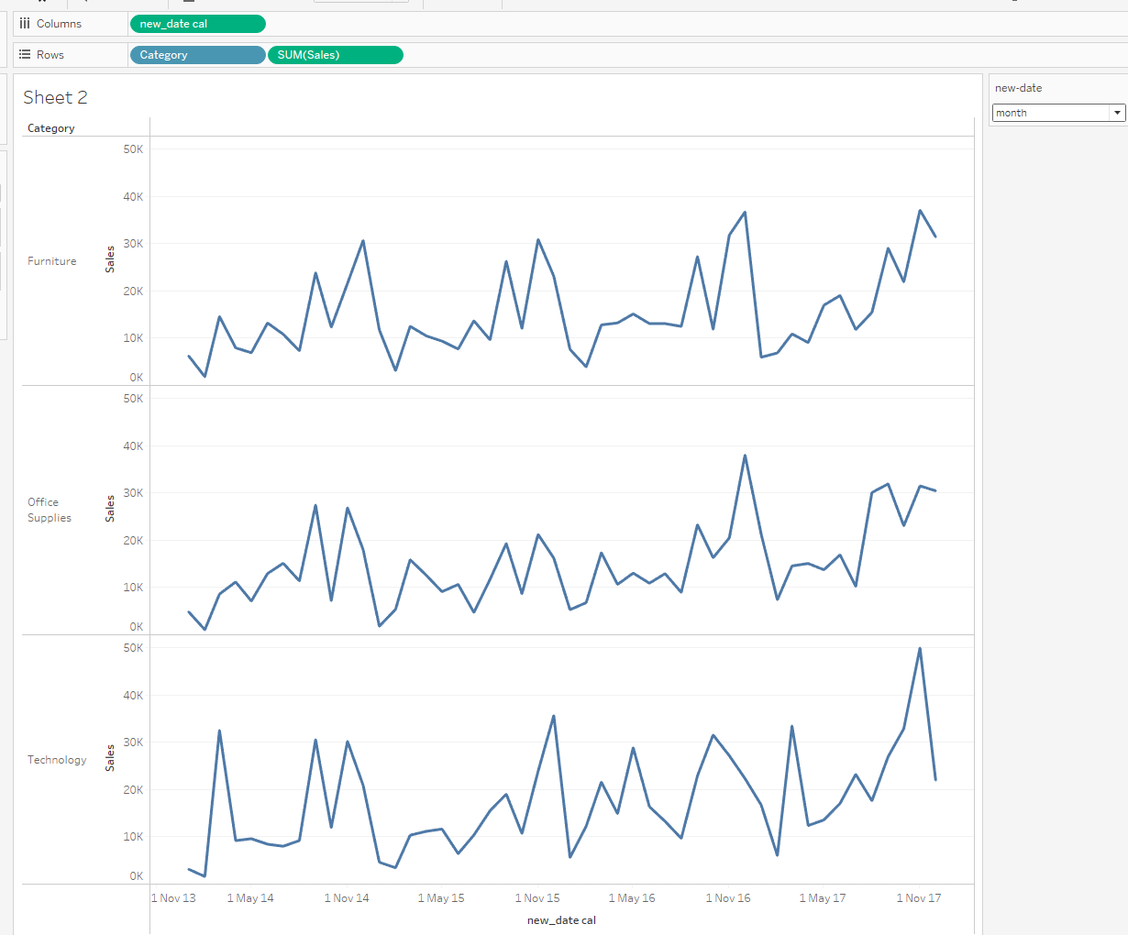

Slide 16
Dynamic Dimensions:
Using parameters we can dynamically display dimensions in tableau.
Create parameter named as dynamic parameter
Data type as String → List Value→ Ship mode, Segment,
Category
2. Next create calculated field and named as Dynamic dimension field
CASE [dynamic parameter]
When “category” then [Category]
when “shipmode” then [shipmode]
when “segment” then [segment]
END
3. Created field drag on cols (category also) and sales on Rows. Now choose value in parameter.

Slide 17
Dynamic Measures:
Create parameter named as dynamic measure
Data type as String → List Value→ sales , profit, Qty
2. Next create calculated field and named as Dynamic measure field
CASE [dynamic measure]
When “sales” then [sales]
when “profit” then [profit]
when “Qty” then [quantity]
END
3. Now click on show parameter.
4. Sub category on cols and newly created field on Rows.

Slide 18
How do we use dynamic measures with multiple number formats in Tableau?
Dynamic measures are often used in Tableau in cases where we want to visualize a certain size depending on other measures. For example, we can analyze product categories according to sales, profit or other measures that interest us. In order not to build every time another graph or dashboard in which to visualize the dimensions according to several measures, we can use dynamic measures built with the help of a parameter.
Step 1: Connect to data
→ In Tableau Desktop, connect to Tableau: Sample Superstore
Step 2: Create the visualization
→ Create a Parameter: Measure Data type: Integer List of values – Display As 1 – Sales 2 – Qty 3 – Profit Ratio
→ Create a Calculated field: Dynamic Measure CASE [Measure] WHEN 1 THEN sum([Sales]) WHEN 2 THEN sum([Quantity]) WHEN 3 then sum([Profit])/sum([Sales])*100 END
→ Create a Calculated field: Prefix CASE [Measure] WHEN 1 THEN ‘$’ WHEN 2 THEN ” WHEN 3 THEN ” END
→ Create a Calculated field: Sufix CASE [Measure] WHEN 1 THEN ” WHEN 2 THEN ‘ q’ WHEN 3 THEN ‘%’ END
→ Drag Dynamic Measure on Columns
→ Drag Category and Sub-category on Rows
→ Drag Dynamic Measure, Prefix and Sufix on Text
→ Click on Label and edit text: <Prefix ><AGG(Dynamic Measure)><Sufix>

Slide 19
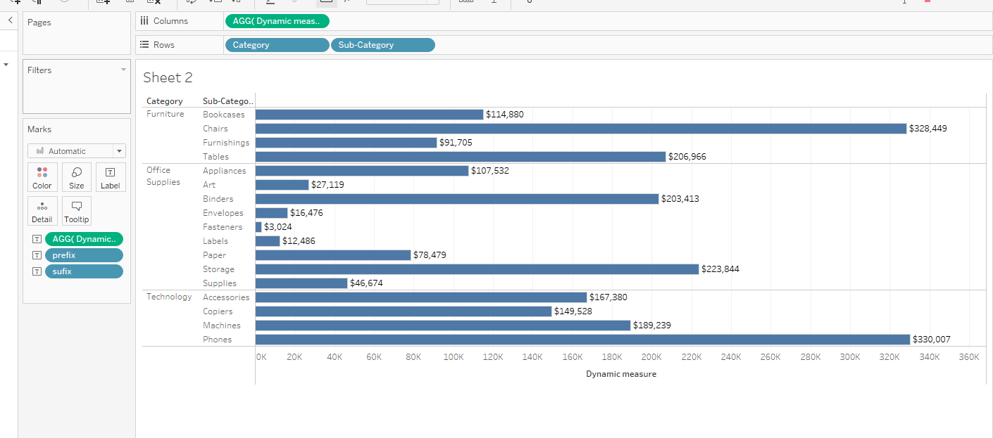

Slide 20
Both Dynamic Measure and Dynamic Dimension :
Dynamic dimension on cols
Dynamic measure on Rows
Select Label option
Reference Lines:
Reference Lines allow us to place lines on the plot at specific locations to mark important values.
We could use these to mark control limits or to indicate a trend line for a set of data.

Slide 21
Reference Lines , Reference Band and Distribution
Reference lines are the horizontal or vertical lines that act as a reference or baseline for a certain measure against which they are compared.
For example, if we are analyzing the annual revenue for several companies, we can include a reference line at the average sales value to see how each company performed against the average.
Creating a reference line is an extremely useful part of analysis and visualization.
Ex:
Drag the Category and Subcategory variables into the Columns shelf and the Sales variable into the Rows shelf.
The next step is to drag the Profit variable to the Marks shelf and place it in the Color option. This will result in a bar chart where sales is plotted as bars, and the color difference will represent the profit of each subcategory with respect to the sales.
The next step is to add a reference line, which can be done in two ways. The first method is to click on the Analytics pane of the Tableau desktop, which will display three options in the Custom tab. Simply dragging the reference line into the view section will add it to the chart.
The second method is to add through the Measure axis in the view by right clicking on the axis, as shown below, and selecting the Add Reference Line option.

Slide 22
5. In both the methods discussed above—dragging the reference line from the Analytics pane or adding a reference line through the Measure axis—a pop-up window is generated that contains options defining the scope of the reference line.
There are three options.
a. Table: This option adds a reference line to the entire table across all panes.
b. Pane: This option adds a reference line on a per pane basis. This means the computed reference lines are recalculated for each pane in the view.
c. Cell: This option adds a reference line within each cell. This means the computed reference lines are recalculated for each cell in the view.
The next option is Label, which denotes the label of the reference line. We have four options:
a. None: No label will be displayed, which is not a self-explanatory option.
b. Value: This option will display the value of the selected aggregation.
c. Computation: This option will display the computation being performed.

Slide 23
Creating a Reference Line Parameter in Tableau
This example is to make a dynamic target that a user can control to quickly see which dimensions fall above or below the target.
Before creating the parameter, let’s build a quick chart by adding Subcategory onto Columns and Sales onto Rows.
Now for the parameter, let's follow these steps.
Click the arrow next to the field search bar, and select Create Parameter.
Name the parameter “Para Subcategory Target.”
Change the data type to Integer.
Change the current value to 5,000.
Click OK.
When click OK, a new section in the calculated field pane appears, named “Parameters.” In that list, we should see the Para Subcategory Target.
If we right-click on the parameter and select Show Parameter, the parameter control section appears on the left.
It will produce a box that looks similar to the filter, with the title “Para Subcategory Target” and the value 5000.

Slide 24
Parameters on their own aren't helpful, so we must always take the second step of adding them either to our visualization or to a calculated field.
For example, if you type 6000 into the parameter control, nothing will change in our bar chart.
Let’s add this parameter to the chart.
At the top of the field list there’s an option to change the pane to “Analytics.”
In the Analytics pane, drag a reference line onto the chart.
For Value select from parameter and pick the Para Subcategory Target.
Click fill below, and select red.
With this, we have a dynamic target, and we can easily see which subcategories are underperforming.

Slide 25
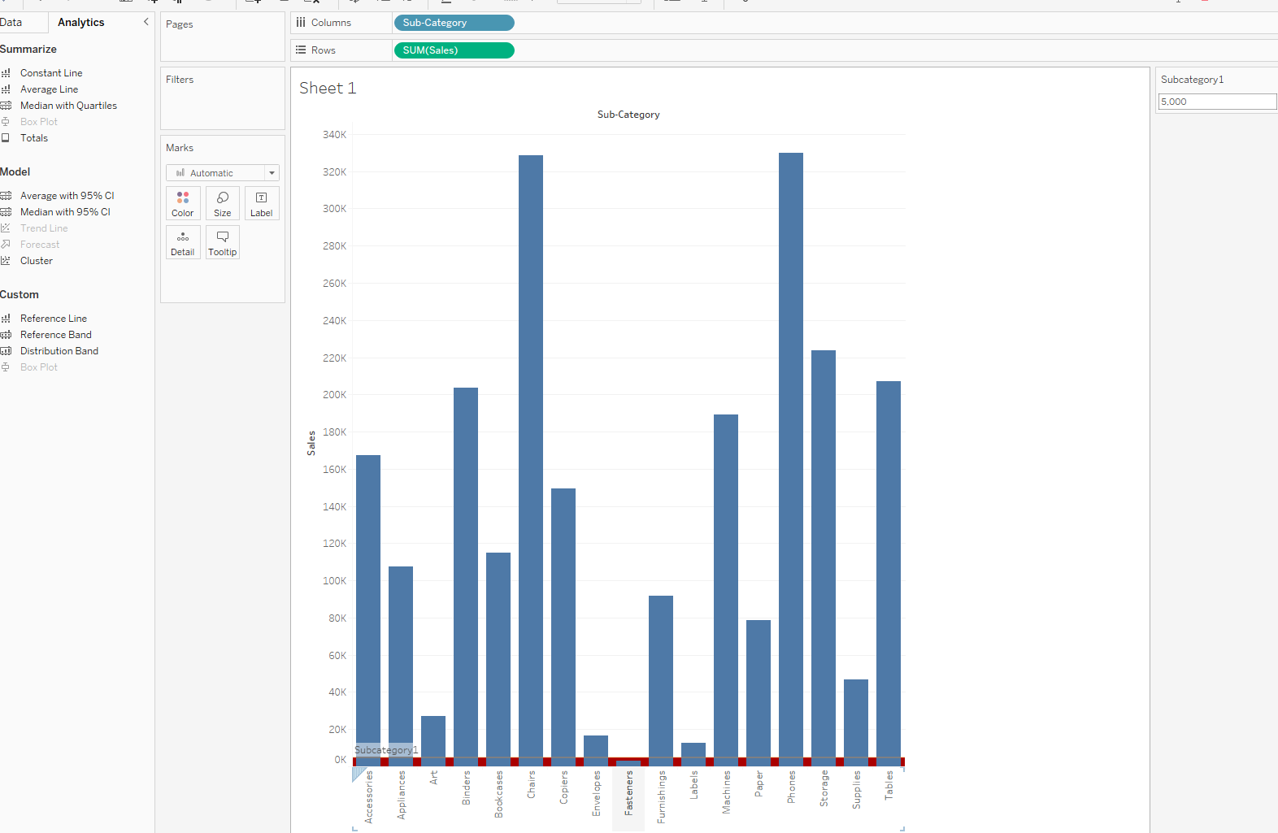

Slide 26
